Slide 1

FINAL PROJECT WITH R
Time series ANALYSIS AND REGRESSION
By: Camila asprilla
Prof. Parenteau
sT. THOMAS UNIVERSITY

Slide 2
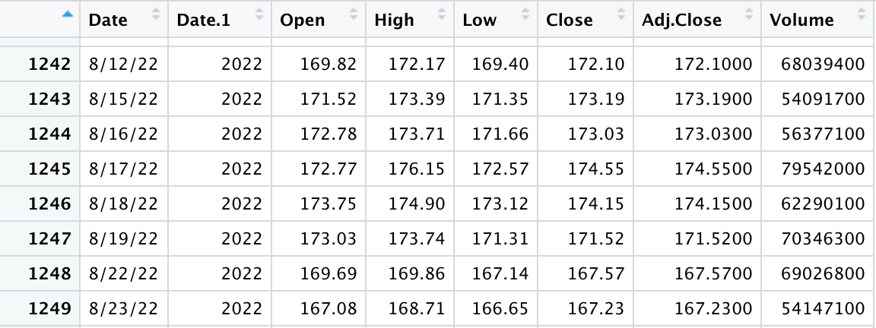
TIME SERIES ANALYSIS
“Time series analysis is a specific way of analyzing a sequence of data points collected over an interval of time. ”
In this case, Daily Closing Price of the three stocks from September 7, 2017 – September 6, 2022.

Slide 3




COMPANIES

Slide 4
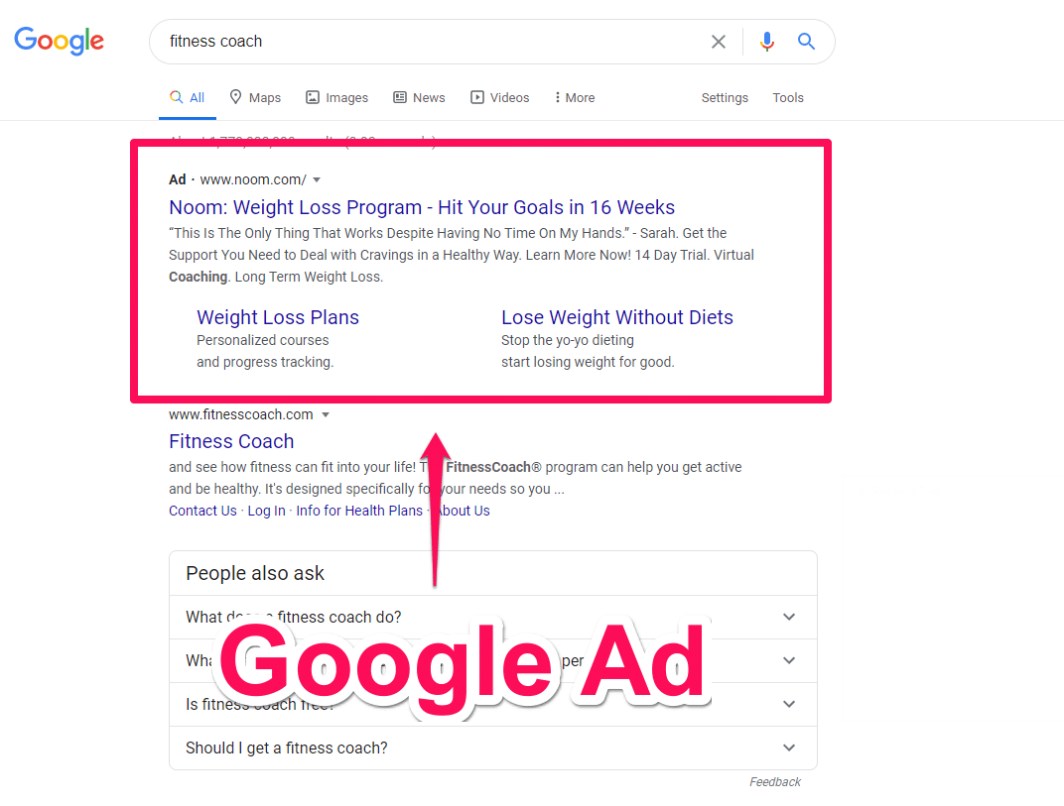
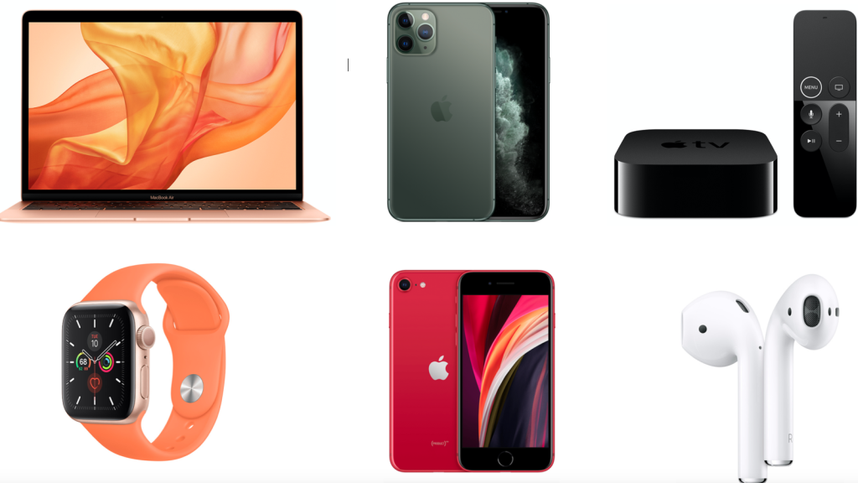
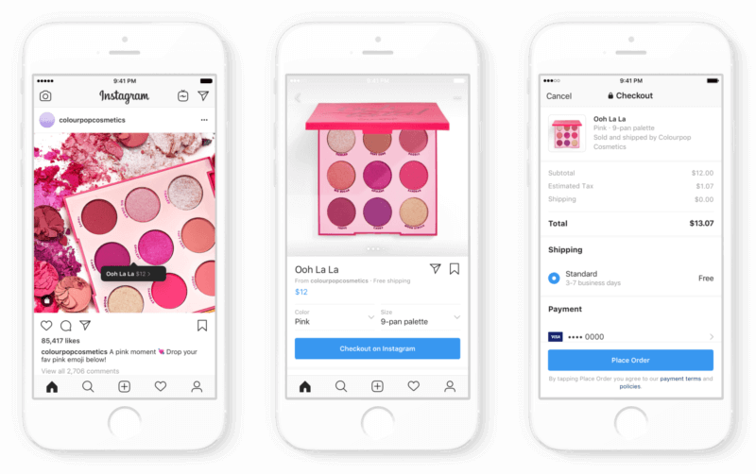
REVENUES AND PRODUCTS
APPLE (AAPL)
GOOGLE (GOOG)
META/FB (META)
Notes:
SOURCES:

Slide 5
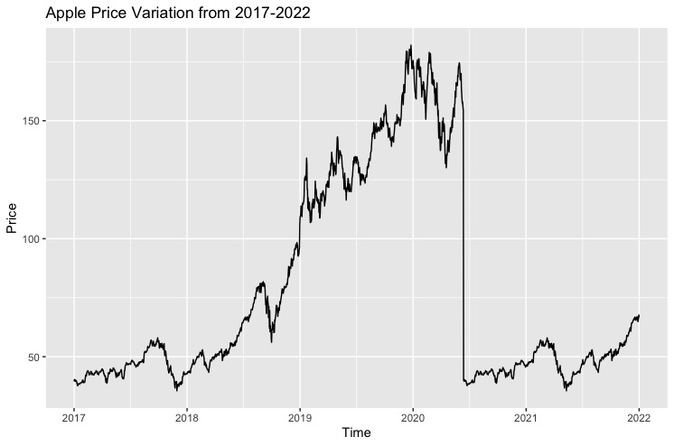
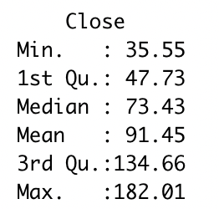
Increases in purchases during Christmas
Lowest price in 2020 and 2017
Average price of $91
Stock appreciation

Slide 6
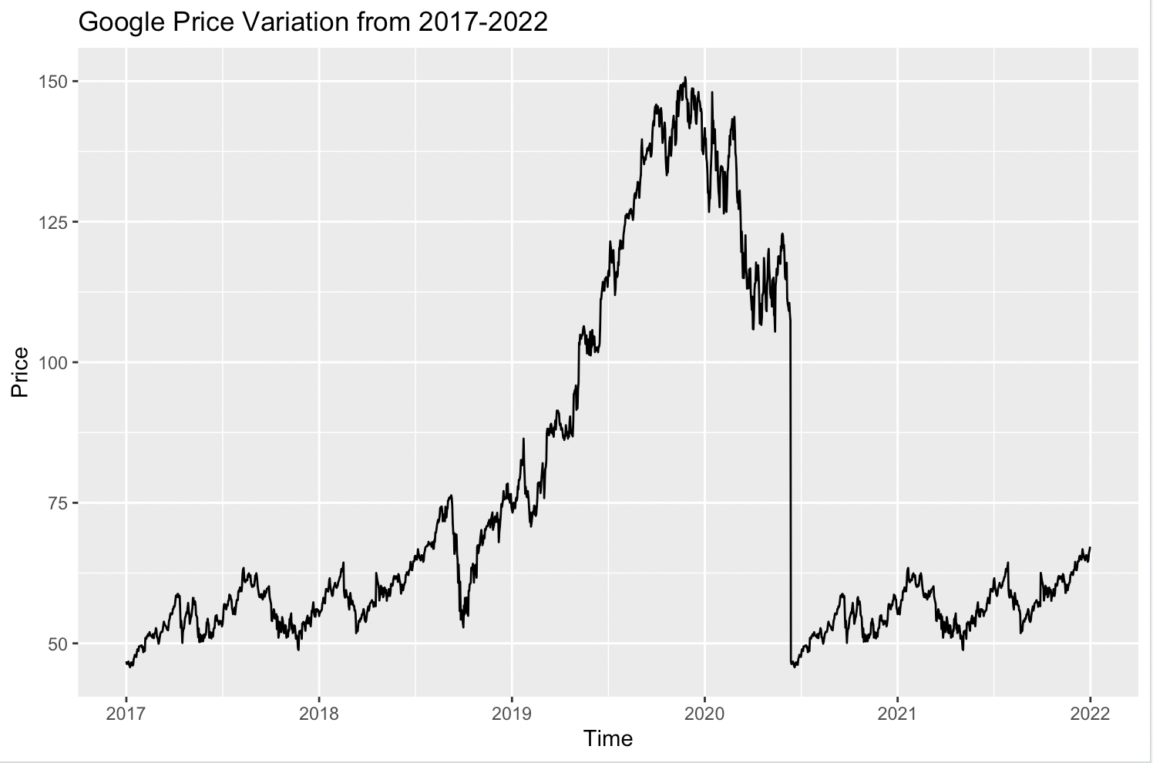
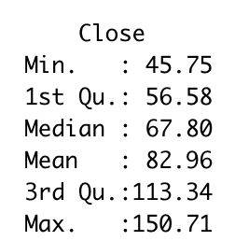
Increases in purchases during Christmas
Lowest price in 2020
Average price of $82
Stock appreciation

Slide 7
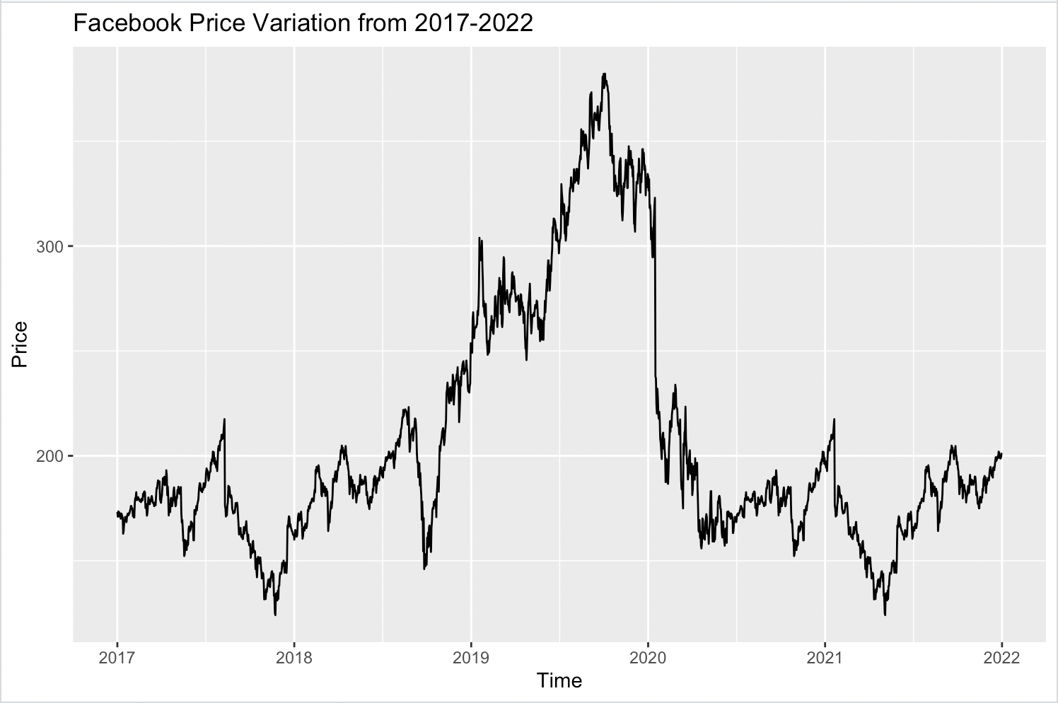
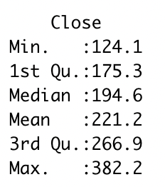
Increases in purchases during Christmas
Lowest price in 2020 and 2017
Average price of $221
Stock appreciation

Slide 8
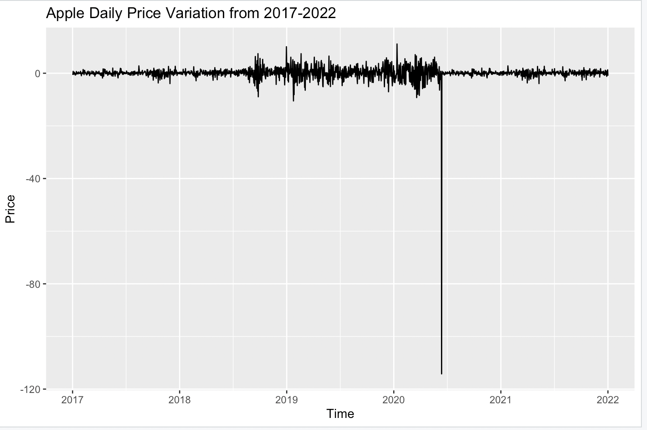

Slide 9
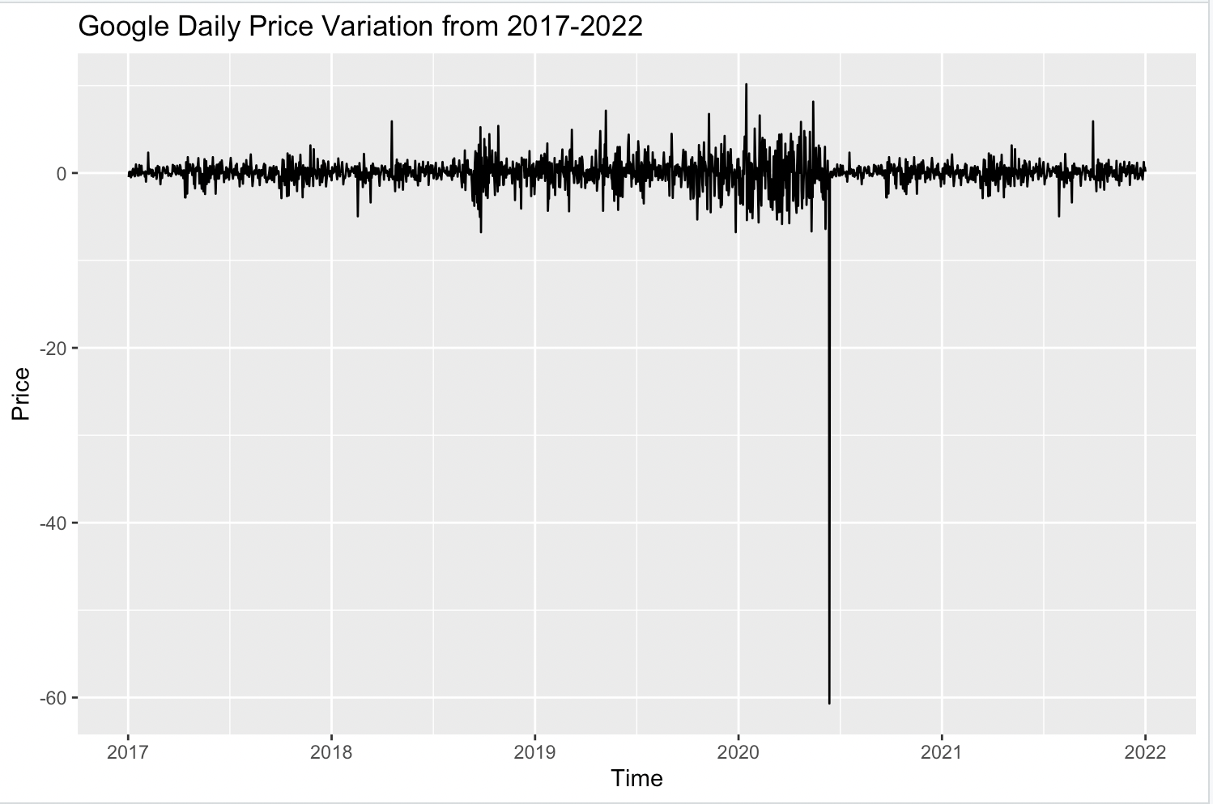

Slide 10
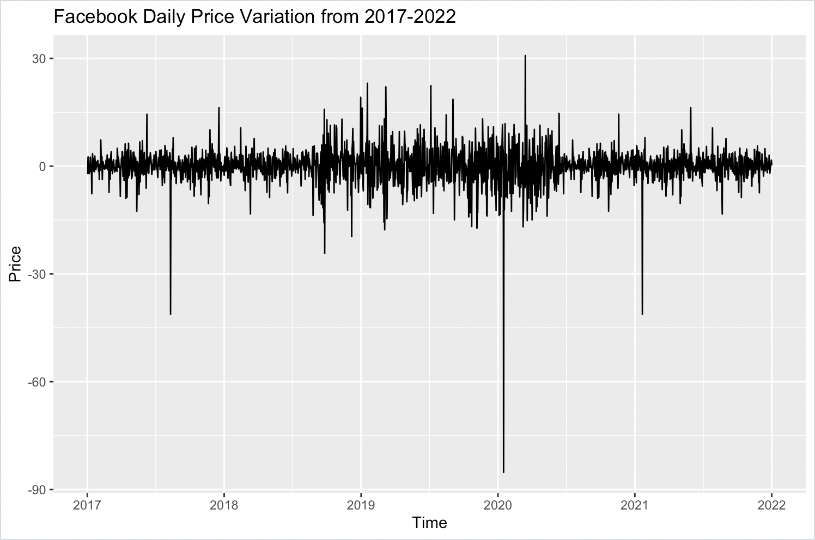

Slide 11
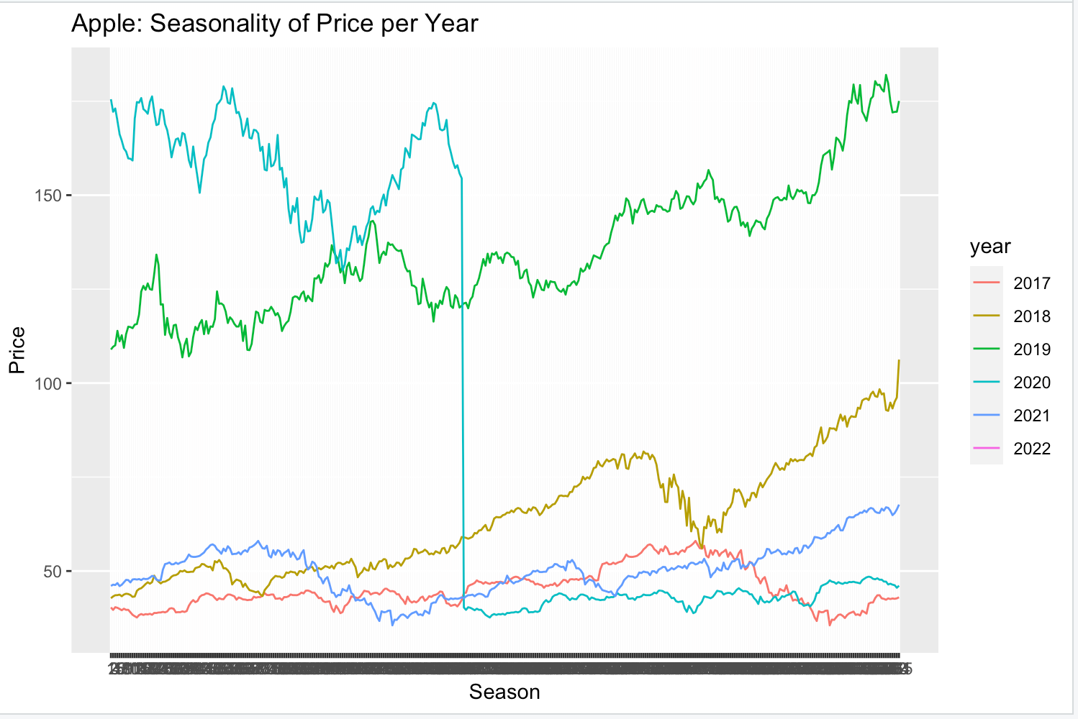
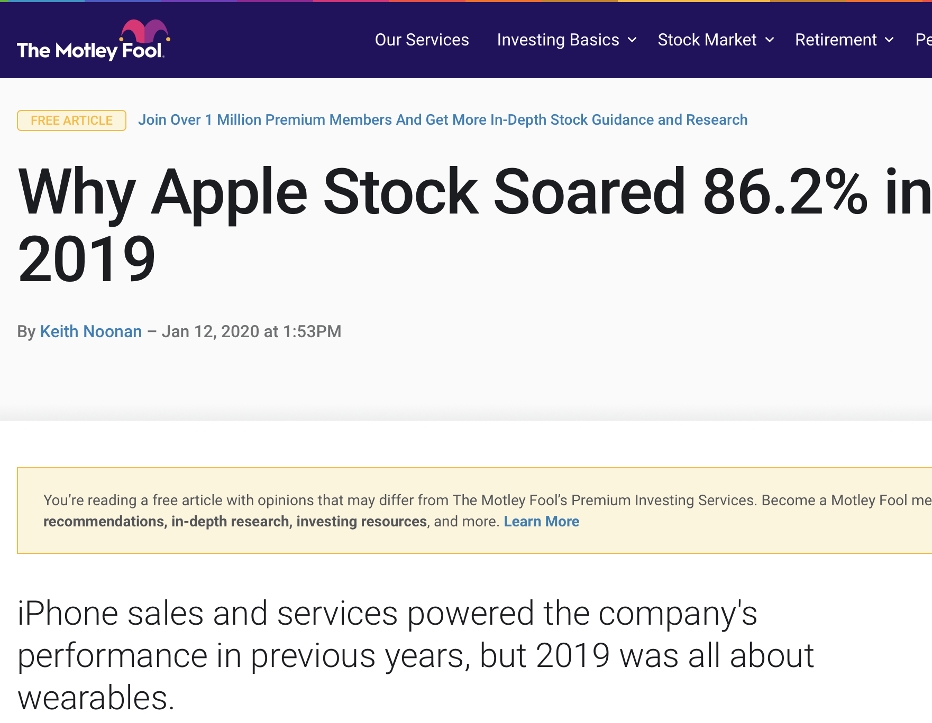
2019 Best year in financial terms

Slide 12
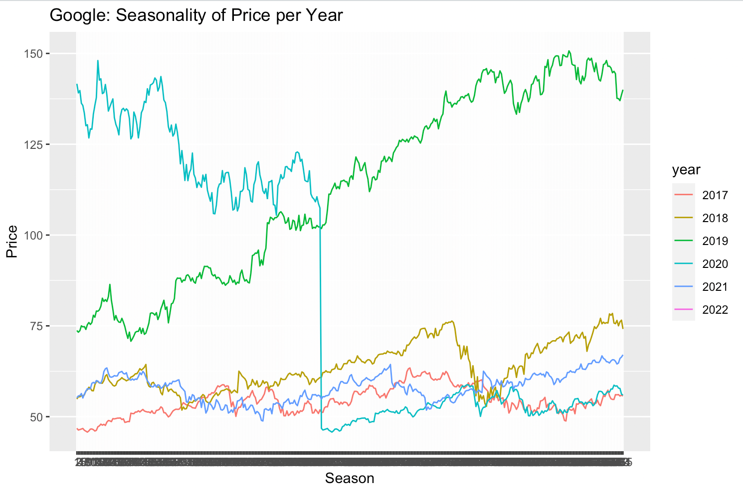
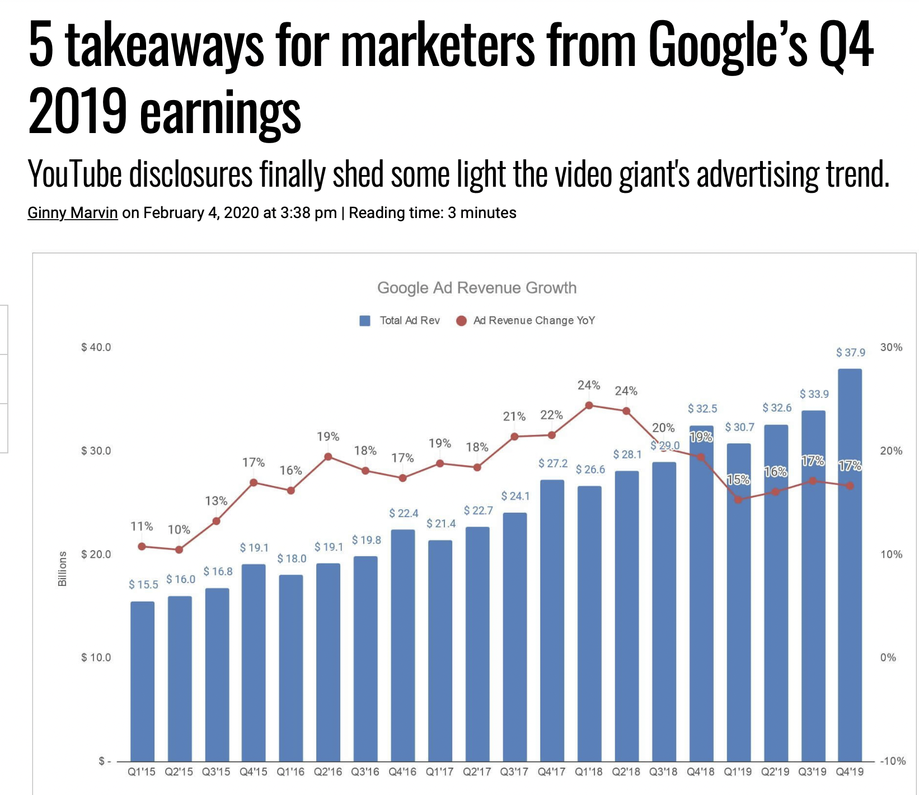
2019 Best year in financial terms

Slide 13
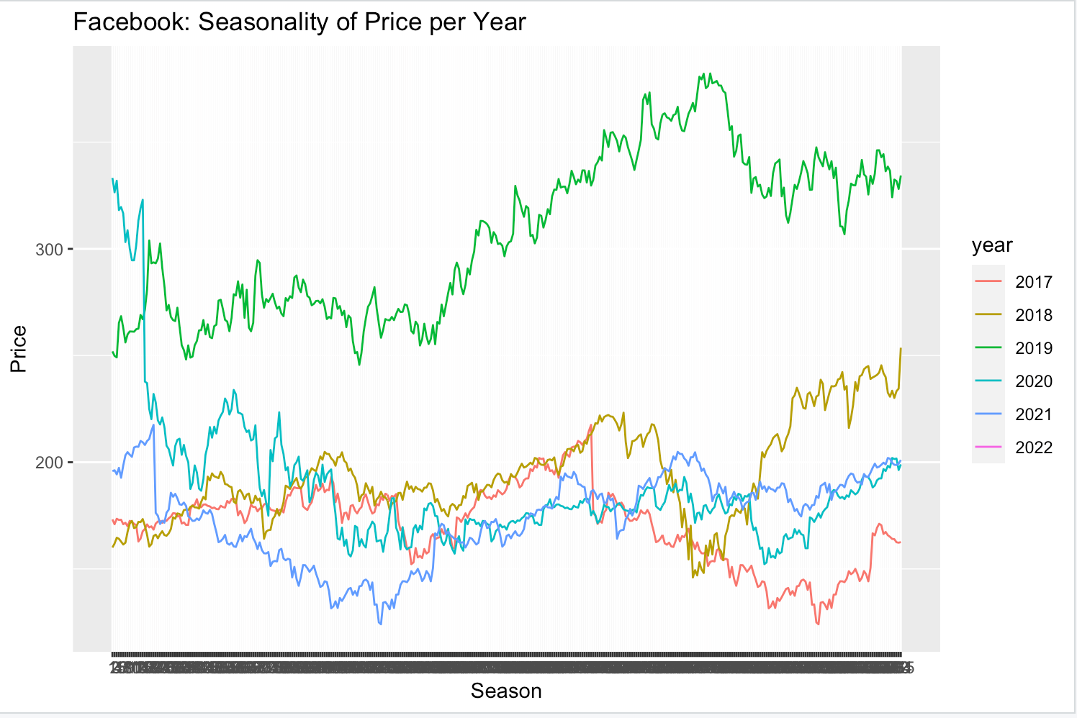
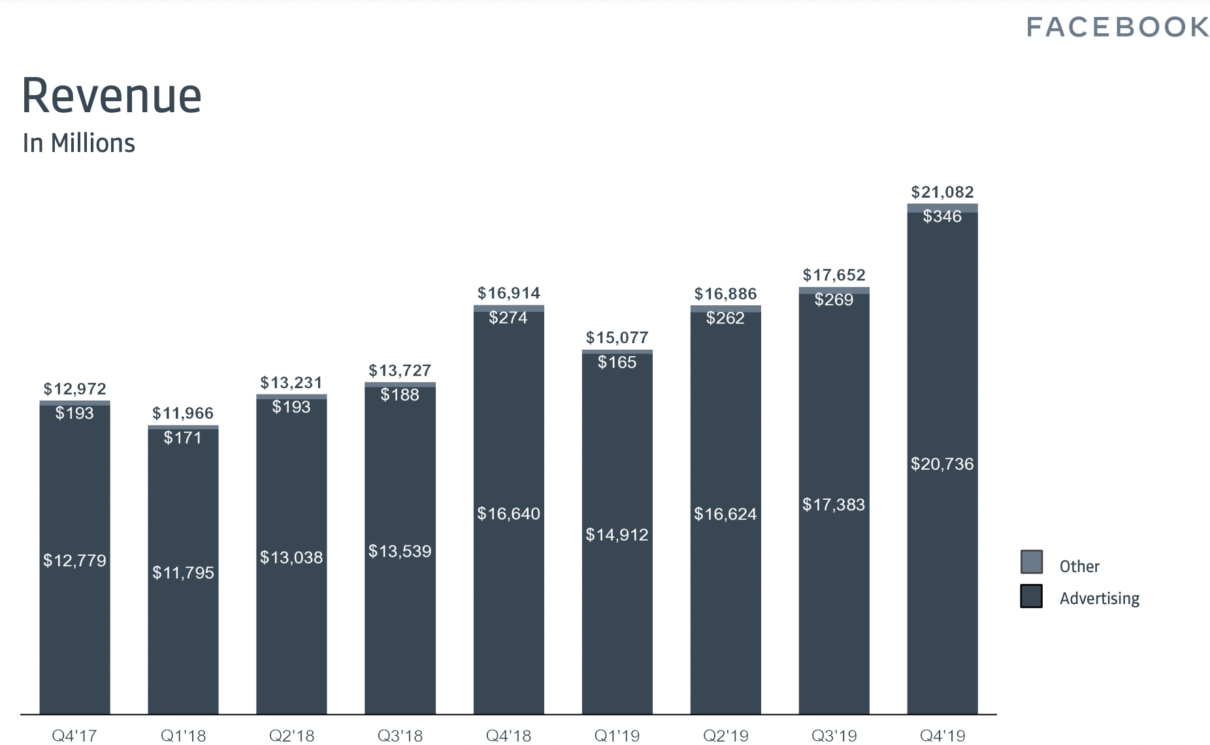
2019 Best year in financial terms

Slide 14
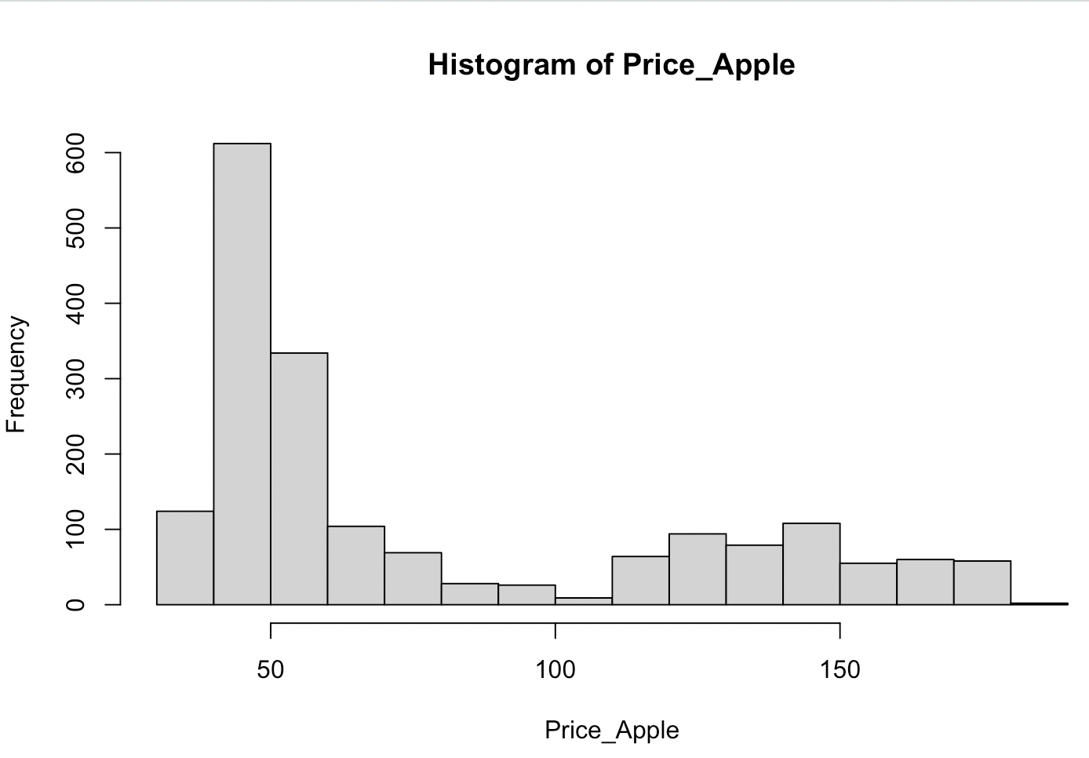
“A histogram is a graphical representation of data points organized into user-specified ranges”

Slide 15
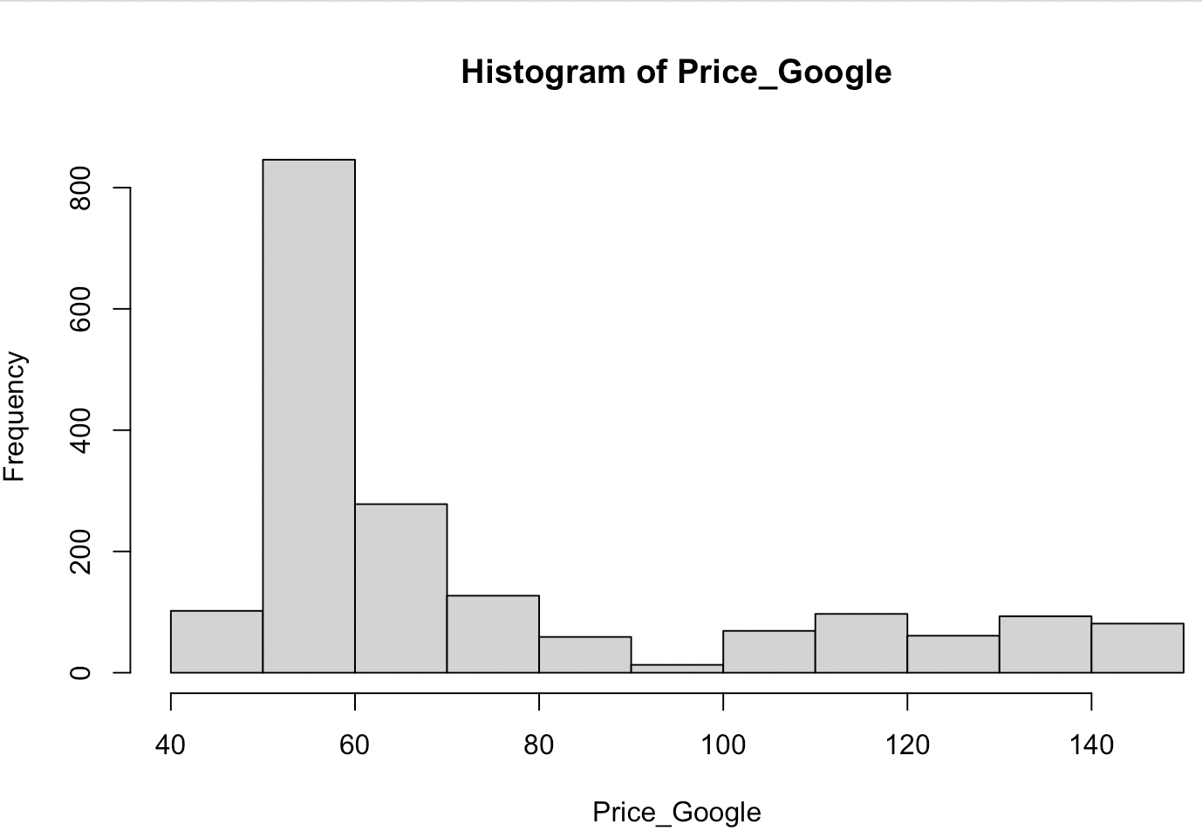
“A histogram is a graphical representation of data points organized into user-specified ranges”

Slide 16
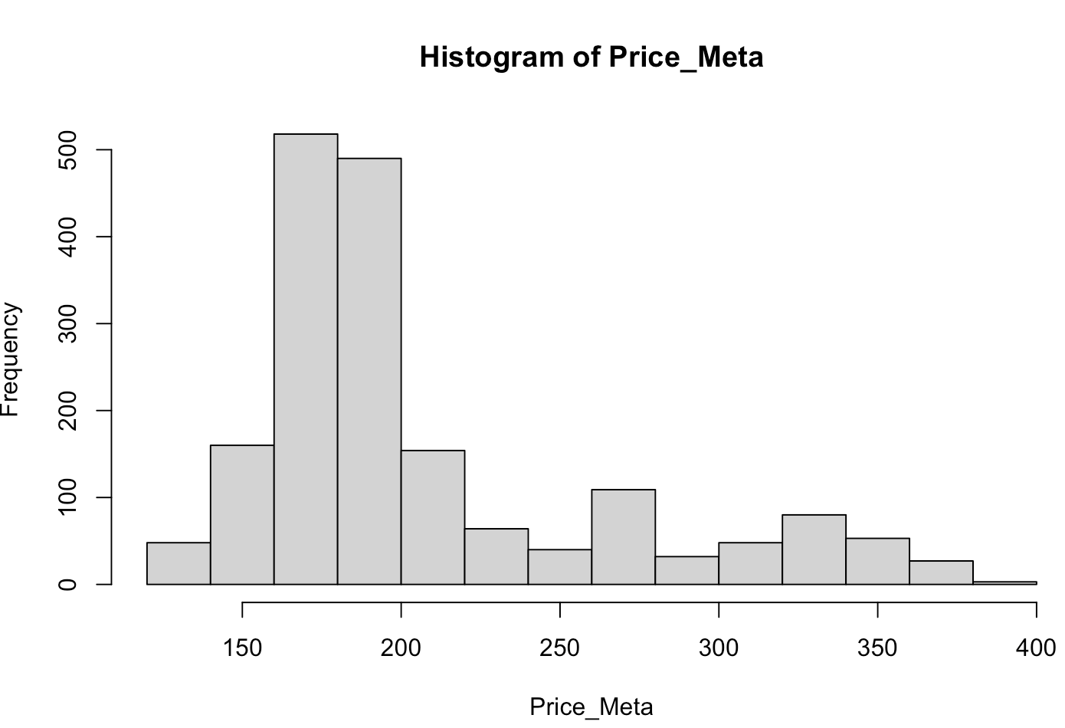
“A histogram is a graphical representation of data points organized into user-specified ranges”

Slide 17
Regression analysis

Slide 18
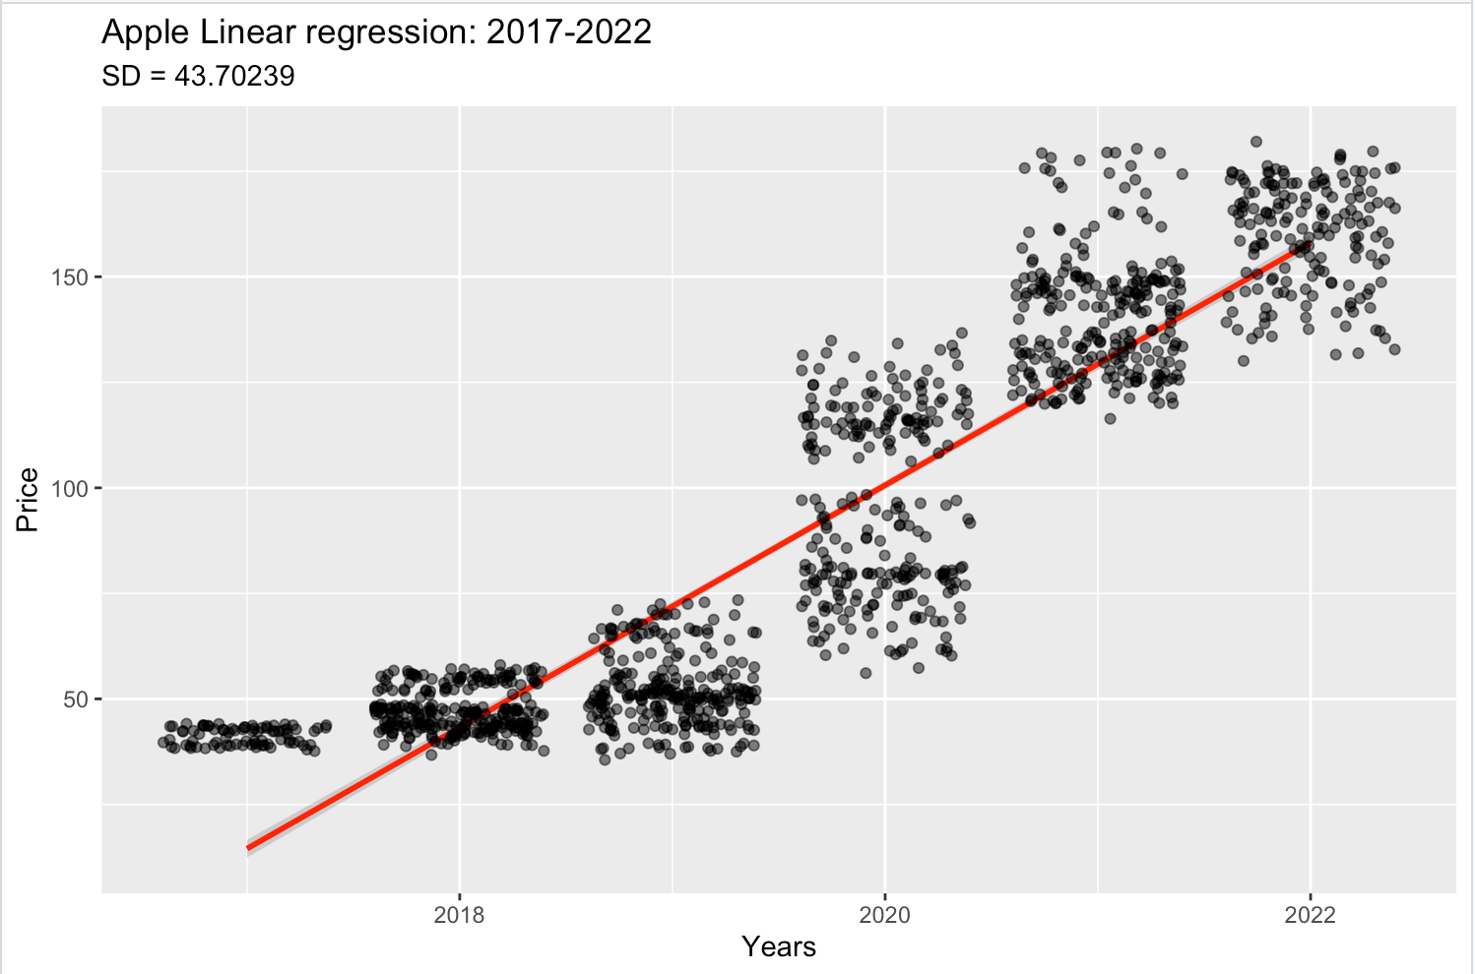
Less price variability
More price variation

Slide 19
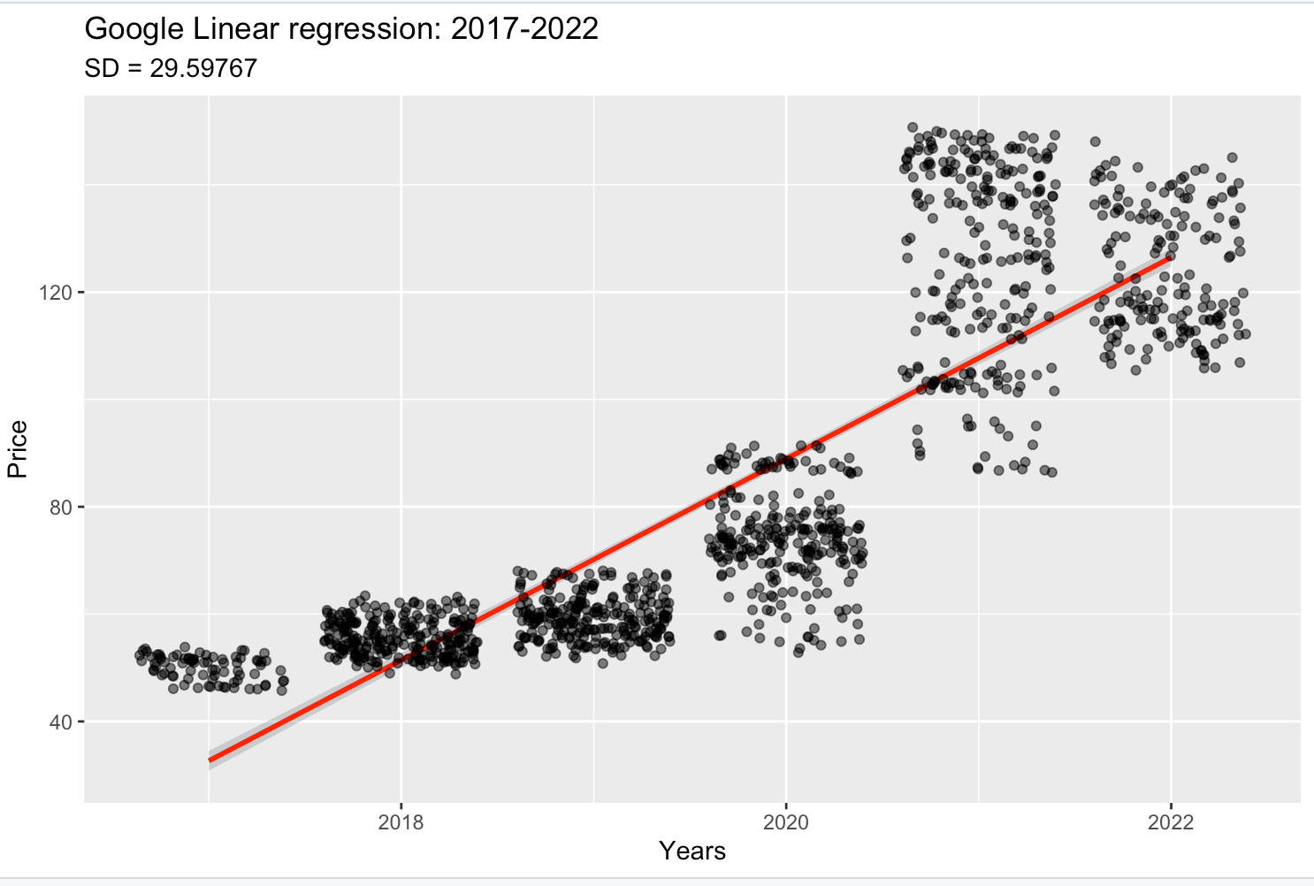
Less price variability
More price variation

Slide 20
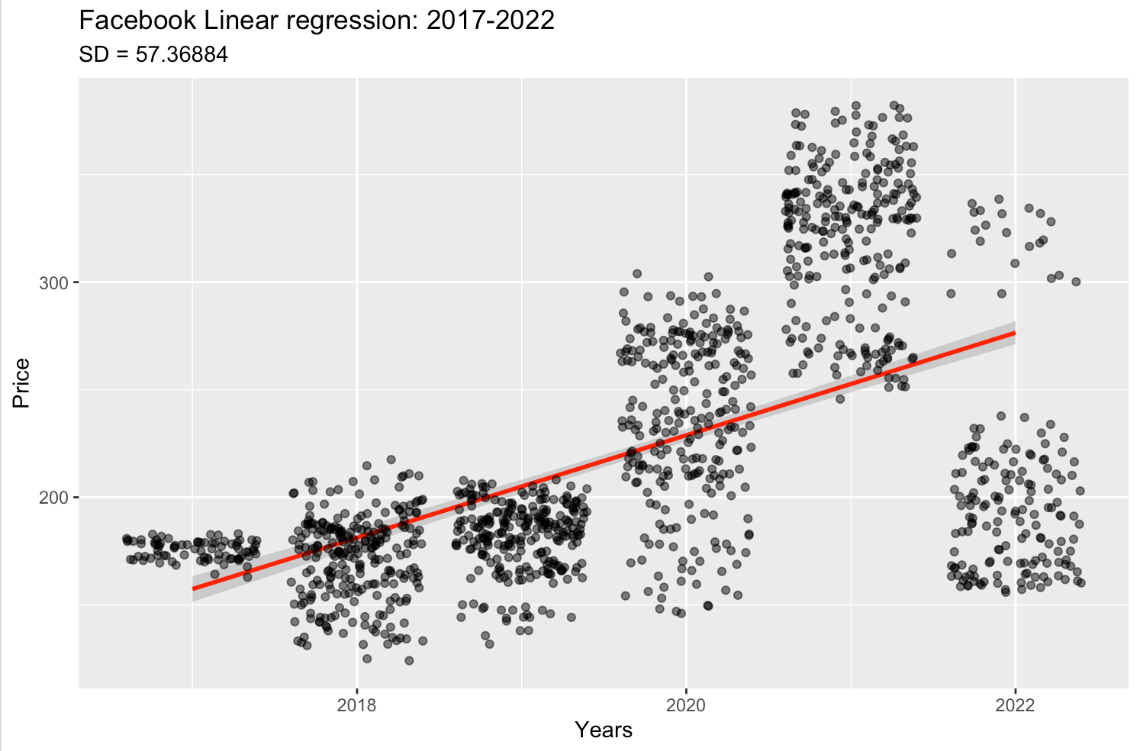
Less price variability
More price variation

Slide 21
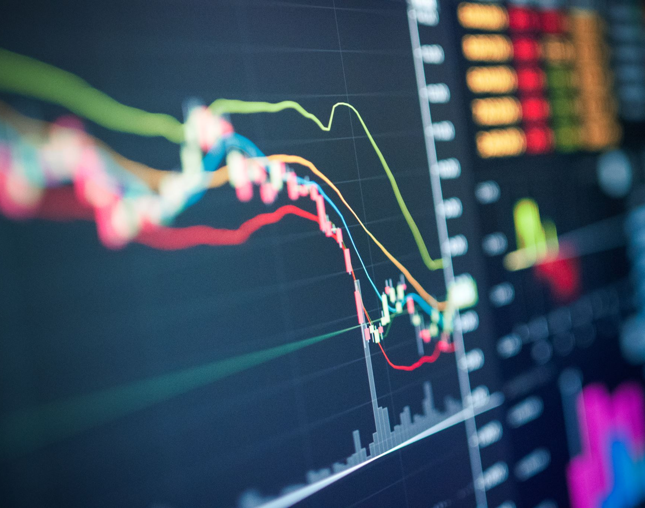
Conclusions
2019 was the best year in financial terms for the tech industry based on the three stock analyses performed
The lowest prices were recorded during the pandemic for all three companies
Even thought these 3 companies have different sources of revenue and sell different products and services, they were all significantly affected by the pandemic
All three companies are still recovering from the pandemic even with the current slow economic growth
Facebook has the slowest growth even thought it had the most valuable stock price, this may also be attributed to the scandal that led to the re-branding of the company

Slide 22
SOURCES
https://www.tableau.com/learn/articles/time-series-analysis
https://www.fool.com/investing/2020/01/12/why-apple-stock-soared-862-in-2019.aspx
https://s21.q4cdn.com/399680738/files/doc_financials/2019/q4/Q4-2019-Earnings-Presentation-_final.pdf
https://searchengineland.com/5-takeaways-for-marketers-from-googles-q4-2019-earnings-328655
https://www.investopedia.com/terms/h/histogram.asp
https://www.youtube.com/watch?v=dBNy_A6Zpcc&t=1955s

